Slide 3
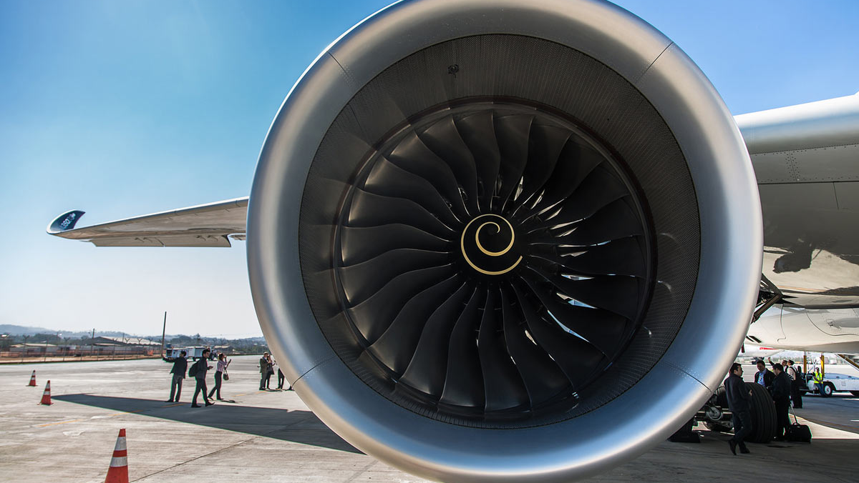

Pawsey Uptake 2025
²
¹
M. Rosenzweig¹, M. Reissmann¹, M. Lee¹, M. Kozul¹, R. D. Sandberg¹
S. Liu², Elahi, P. ²

Slide 5
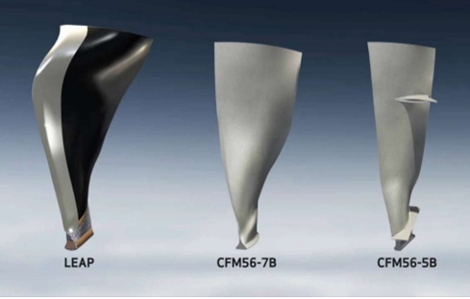
Fan blade design evolution
new design
old design
Continuous increasing
in DOF

Slide 6
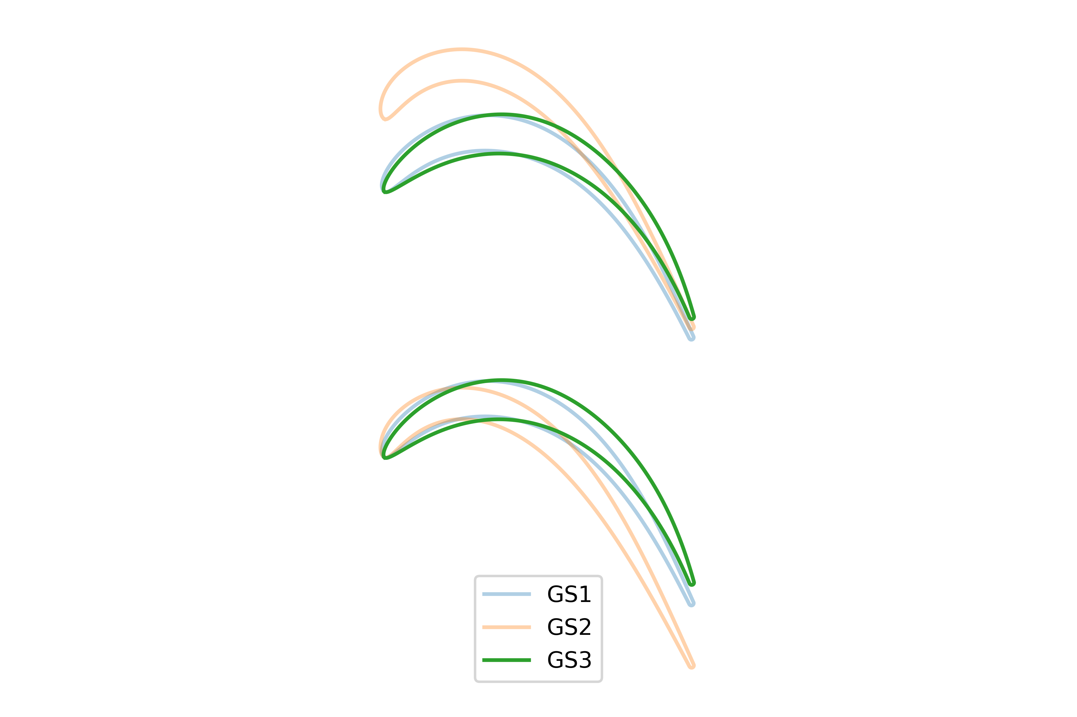
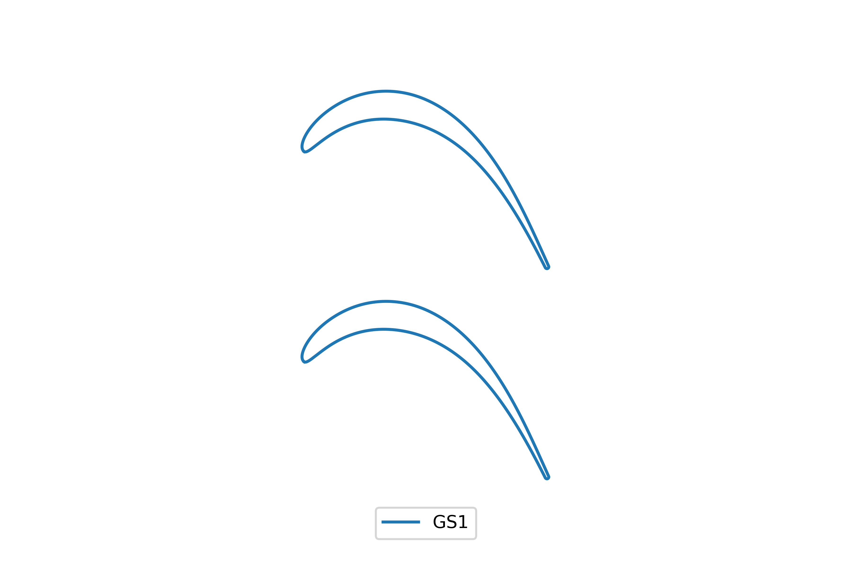
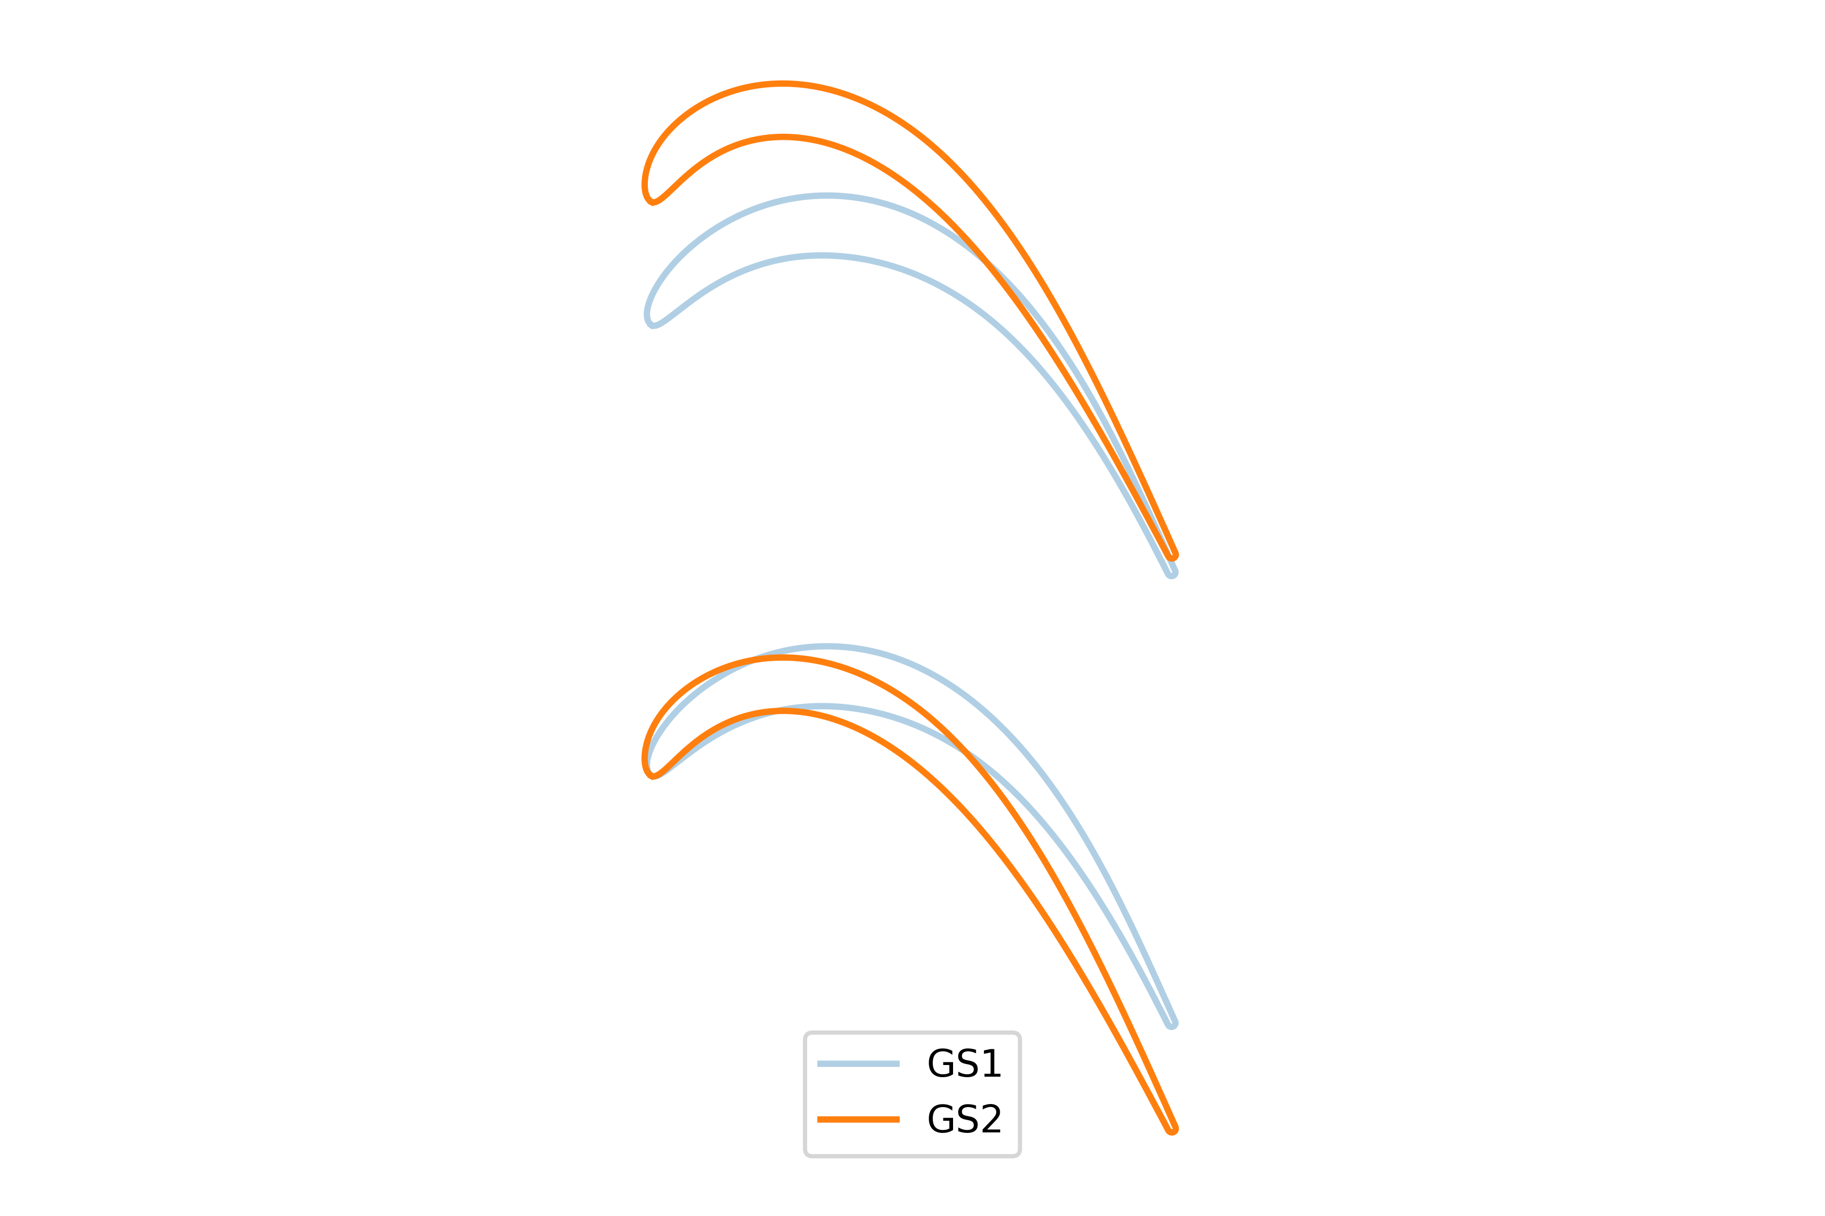
Pawsey Uptake Project: Quantum-based blade design
Creation of blade profiles
Evaluation of blade aerodynamics via computational fluid dynamics across various in-flight conditions
Training machine-learned surrogate/ reduced-order model (ROM)
ROM as input parameter for quantum-based optimization
Notes:
one of the geometries of interest is representative of a conventional blade profile

Slide 7
Proposed timeline and resources
Jul | Aug | Sep | Oct | Nov | Dec
Blade creation and CFD evaluation
Surrogate model training
Quantum-based optimization
Wrap-up
ML and CUDA-Q familiarization

Slide 8
Proposed timeline and resources
Jul | Aug | Sep | Oct | Nov | Dec
0.2 FTE of Pawsey staff (Pascal and Shusen) → weekly-meetings
Access to Pawsey’s NVIDIA GH200 nodes? -> OK
monthly meetings with NVIDIA and ORNL for progress report?
Scope: What can we do with QC in the field of jet engines?
Iterative loop (further down the line)

